Slide 1
Gaussian
CS 109
Lecture 10
April 18th, 2016

Slide 2
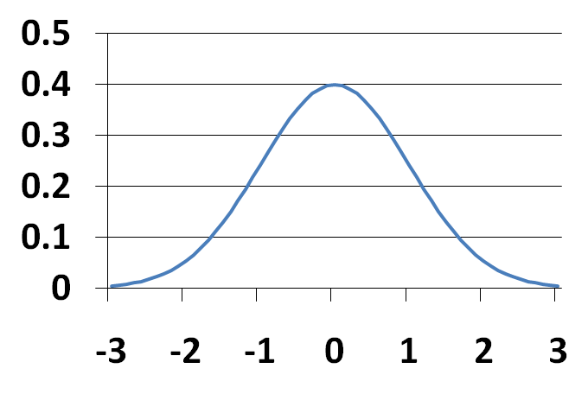
The Normal Distribution
X is a Normal Random Variable: X ~ N(μ, σ ²)
Probability Density Function (PDF):
Also called “Gaussian”
Note: f(x) is symmetric about μ
μ

Slide 3
Why Use the Normal?
Common for natural phenomena: heights, weights, etc.
Often results from the sum of multiple variables
Most noise is Normal

Slide 4


Four Prototypical Trajectories
Or that is what they want
you to believe

Slide 5
Except Not
These are log-normal
Common for natural phenomena: heights, weights, etc.
Often results from the sum of multiple variables
Most noise is Normal
Only if they are equally weighted
I wish it were that easy

Slide 6
Four Prototypical Trajectories
It is the most important distribution

Slide 7
Four Prototypical Trajectories
Because of a deeper truth…

Slide 8
Supervised Learning
Training Data Set (x, y)
World Model (𝜃)
Key question: How well can you generalize
Learning Algorithm
Trained Model
Predicted
y
Test x

Slide 9
Occam’s Razor
“The simplest explanation is usually the best one”

Slide 10
Overfiting
Just right
Too complex
Training Set
Goodness of Fit
Testing Set
Model Degrees of Freedom

Slide 11
Complexity is Tempting
Probably over fitting…
probability
value
* That describes the training data, but will it generalize?

Slide 12
Simplicity is Humble
Simple. Will generalize
μ
probability
σ²
value
* A Gaussian maximizes entropy for a given mean and variance

Slide 13
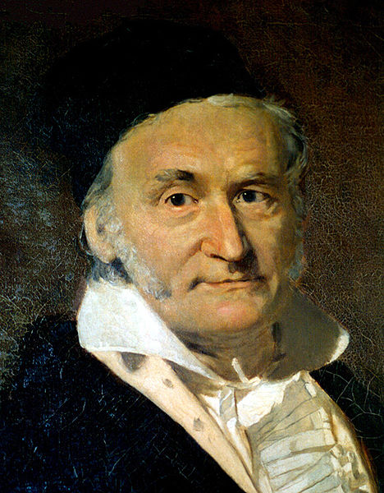

Carl Friedrich Gauss
Carl Friedrich Gauss (1777-1855) was a remarkably influential German mathematician
Started doing groundbreaking math as teenager
Did not invent Normal distribution, but popularized it
He looked more like Martin Sheen
Who is, of course, Charlie Sheen’s father

Slide 14
Anatomy of a beautiful equation
the distance to the mean
“exponential”
probability density at x
sigma shows up twice
a constant

Slide 15
Let’s try and integrate it!
* Call me if you find an equation for this

Slide 16
Four Prototypical Trajectories
No closed form for the integral

Slide 17
Four Prototypical Trajectories
No closed form for F(x)

Slide 18
Spoiler Alert
A function that has been solved for numerically
The cumulative density function of any normal
* We are going to spend the next few slides getting here

Slide 19
Linear Transform of Normal is Normal
If
then Y is also Normal

Slide 20
Special Linear Transform
If
then Y is also Normal
There is a special case of linear transform for any X:

Slide 21
Standard (Unit) Normal Variable
Z is a Standard (or Unit) Normal RV: Z ~ N(0, 1)
E[Z] = m = 0 Var(Z) = s ² = 1 SD(Z) = s = 1
CDF of Z, F_{Z}(z) does not have closed form
We denote F_{Z}(z) as Φ(z): “phi of z”
By symmetry: Φ(–z) = P(Z ≤ –z) = P(Z ≥ z) = 1 – Φ(z)

Slide 22
Symmetry of Phi
ɸ(-a) = 1 – ɸ(a)
μ = 0
ɸ(-a)
1 – ɸ(a)
-a
a

Slide 23
Interval of Phi
μ = 0
ɸ(c)
ɸ(d)
c
d

Slide 24
Interval of Phi
ɸ(d) - ɸ(c)
μ = 0
ɸ(c)
ɸ(d)
c
d

Slide 25
Compute F(x) via Transform
Use Z to compute F(x)

Slide 26
And here we are
CDF of Standard Normal: A function that has been solved for numerically
The cumulative density function (CDF) of any normal
Table of Φ(z) values in textbook, p. 201 and handout

Slide 27
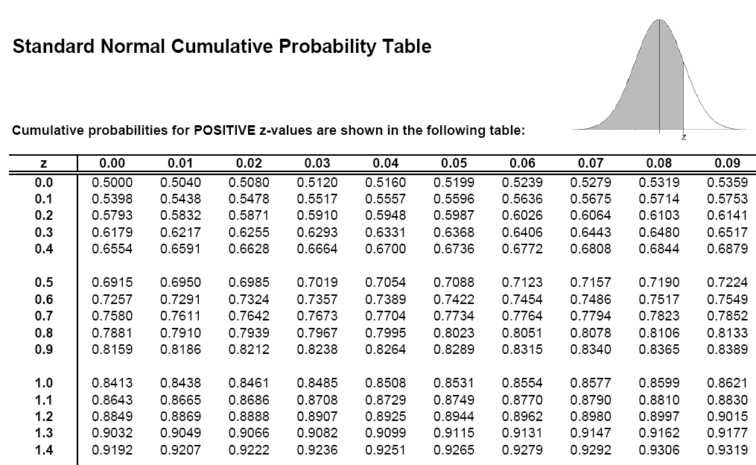
Using Table of ɸ
Φ(0.54) = 0.7054

Slide 28
Four Prototypical Trajectories
Kinda old school

Slide 29
Using Programming Library
norm.cdf(x, mean, std)
* Every modern programming language has a normal library

Slide 30
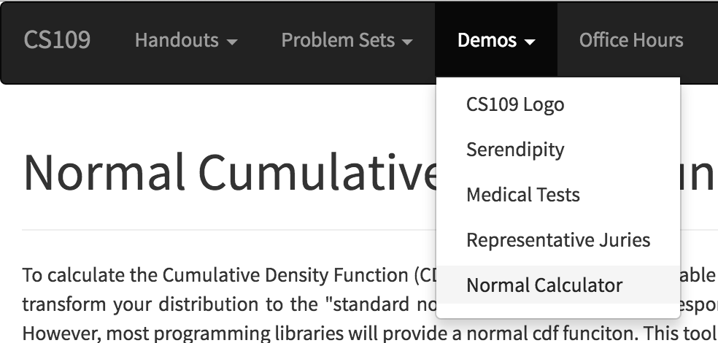
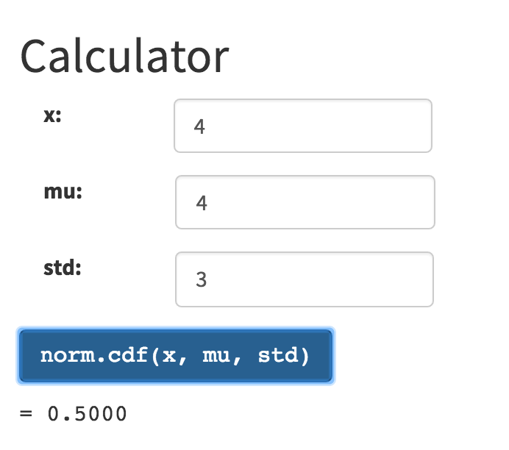
I made one for you

Slide 31
Get Your Gaussian On
X ~ N(3, 16) μ = 3 σ ² = 16 σ = 4
What is P(X > 0)?
What is P(2 < X < 5)?
What is P(|X – 3| > 6)?
0.1337

Slide 32
Noisy Wires
Send voltage of 2 or -2 on wire (to denote 1 or 0)
X = voltage sent
R = voltage received = X + Y, where noise Y ~ N(0, 1)
Decode R: if (R ≥ 0.5) then 1, else 0
What is P(error after decoding | original bit = 1)?
What is P(error after decoding | original bit = 0)?

Slide 33
Four Prototypical Trajectories
Gaussian for uncertainty

Slide 34
ELO Ratings
What is the probability that the Warriors beat the Rockets?
How do you model zero sum games?

Slide 35
ELO Ratings
How it works:
Each team has an “ELO” score S, calculated based on their past performance.
Each game, the team has ability A ~ N(S, 200²)
The team with the higher sampled ability wins.
Arpad Elo
p
1555
1797
ability
Calculated via sampling

Slide 36
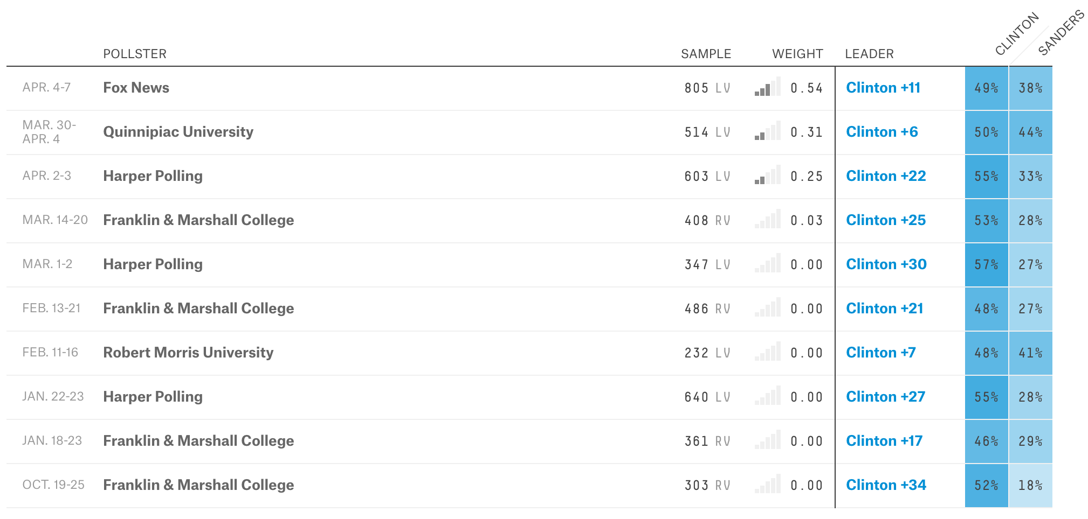
Poll of polls?
Democratic Pennsylvania Primary
Credit: fivethirtyeight.com
What is the probability that Hillary/Bernie wins?

Slide 37
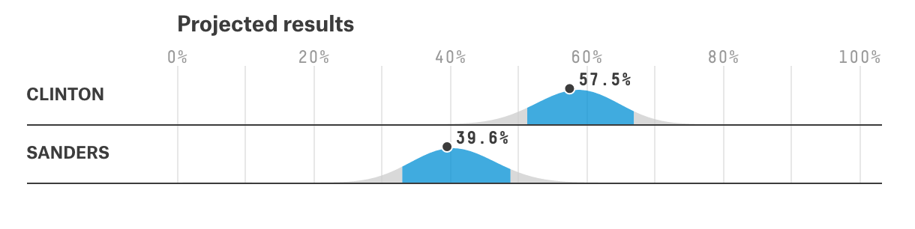
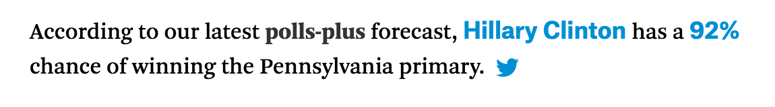
Poll of polls?
Credit: fivethirtyeight.com
How it works:
Estimate a Gaussian for each candidate
Mean is a weighted average of poll means
Variance is a weighted average of poll trust
Sample Gaussians to find out % win
Key: represent uncertainty

Slide 38
Four Prototypical Trajectories
Gaussian for Binomial

Slide 39
Remember this?
There is a deep reason for the Binomial/Normal approximation…

Slide 40
Normal Approximation of Binomial
X ~ Bin(n, p)
E[X] = np Var(X) = np(1 – p)
Poisson approx. good: n large (> 20), p small (< 0.05)
For large n: X ≈ Y ~ N(E[X], Var(X)) = N(np, np(1 – p))
Normal approx. good : Var(X) = np(1 – p) ≥ 10
DeMoivre-Laplace Limit Theorem:
S_{n}: number of successes (with prob. p) in n independent trials
“Continuity correction”

Slide 41
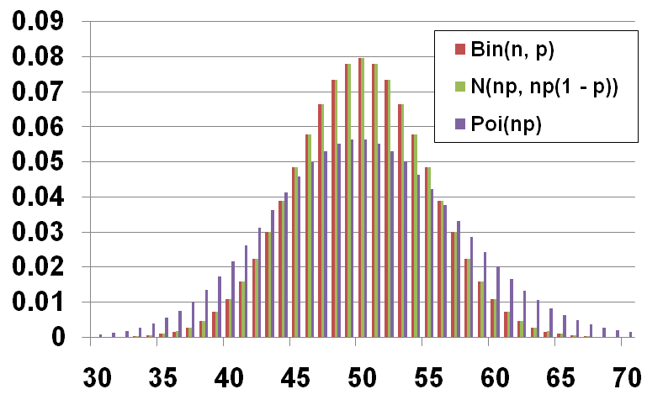
Comparison when n = 100, p = 0.5
P(X = k)
k

Slide 42
Website Testing
100 people are given a new website design
X = # people whose time on site increases
CEO will endorse new design if X ≥ 65 What is P(CEO endorses change| it has no effect)?
X ~ Bin(100, 0.5)
Use Normal approximation: Y ~ N(50, 25)
Using Binomial:

Slide 43
Stanford Admissions
Stanford accepts 2480 students
Each accepted student has 68% chance of attending
X = # students who will attend. X ~ Bin(2480, 0.68)
What is P(X > 1745)?
Use Normal approximation: Y ~ N(1686.4, 539.65)
Using Binomial:

Slide 44
Changes in Stanford Admissions
Stanford Daily, March 28, 2014
“Class of 2018 Admit Rates Lowest in University History” by Alex Zivkovic
“Fewer students were admitted to the Class of 2018 than the Class of 2017, due to the increase in Stanford’s yield rate which has increased over 5 percent in the past four years, according to Colleen Lim M.A. ’80, Director of Undergraduate Admission.”

